Slide 1
CREATE A CHATBOT IN PYTHON
Phase 3 submissions documents
DEVELOPMENTS PART 1

Slide 2
TOPIC : In This sections being your project by loading and preprocessing the dataset
At the beginning of the chatbot development process, however, you may face the lack of training data, which results in low accuracy in intent classification. A few workarounds exist to solve this problem:
Pre-trained model
Training data generator
Crowdsource

Slide 3
LOADING THE CHATBOT IN PYTHON
Preparing the Dependencies. The right dependencies need to be established before we can create a chatbot. ...
Creating and Training the Chatbot. Once the dependence has been established, we can build and train our chatbot. ...
Communicating with the Python chatbot. ...
Complete Project Code.

Slide 4
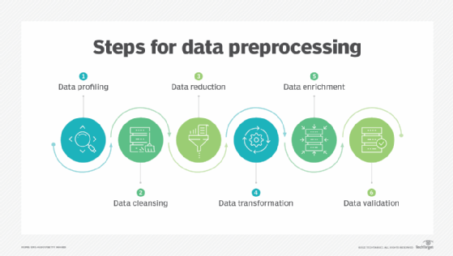
Data preprocessing transforms the data into a format that is more easily and effectively processed in data mining, machine learning and other data science tasks. The techniques are generally used at the earliest stages of the machine learning and AI development pipeline to ensure

Slide 5
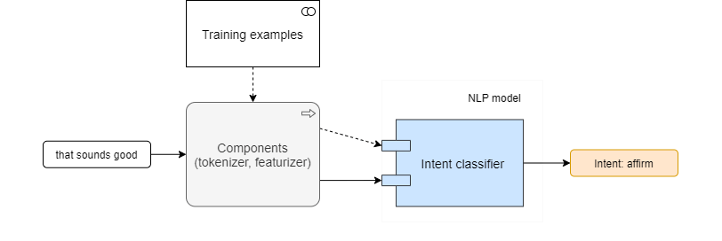
Initial model

Slide 6
language: en pipeline
- name: WhitespaceTokenizer
– name: CountVectorsFeaturizer
- name: CountVectorsFeaturizer analyzer
"char_wb" min_ngram: 1 max_ngram: 4
- name: DIETClassifier epochs: 100
!rasa train -c config-simple.yml --fixed-model-name simple --quiet Training Core model... 2020-06-22 20:46:54.811928: E tensorflow/stream_executor/cuda/cuda_driver.cc:351] failed call to cuInit: CUDA_ERROR_NO_DEVICE: no CUDA-capable device is detected Core model training completed. Training NLU model... /usr/local/lib/python3.6/dist-packages/rasa/utils/common.py:363: UserWarning: You specified 'DIET' to train entities, but no entities are present in the training data. Skip training of entities. NLU model training completed.

Slide 7
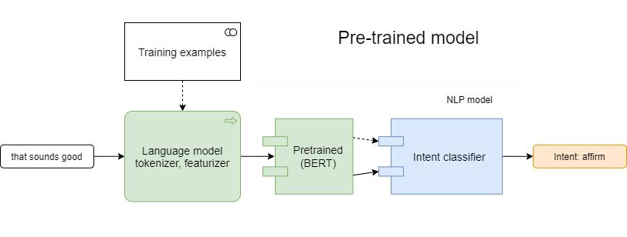
PRE – TRAINED MODEL

Slide 8
Follow the text preprocessing steps for fine-tuning. An example of Fine-tuning
Bert model on the MRPC classification task is given below:
BERT_BASE_DIR=/path/to/bert/uncased_L-12_H-768_A-12
export GLUE_DIR=/path/to/glue
python run_classifier.py \
--task_name=MRPC \
--do_train=true \
--do_eval=true \
--data_dir=$GLUE_DIR/MRPC \
--vocab_file=$BERT_BASE_DIR/vocab.txt \
--bert_config_file=$BERT_BASE_DIR/bert_config.json \
--init_checkpoint=$BERT_BASE_DIR/bert_model.ckpt \
--max_seq_length=128 \
--train_batch_size=32 \
--learning_rate=2e-5 \
--num_train_epochs=3.0 \
--output_dir=/tmp/mrpc_output/

Slide 9
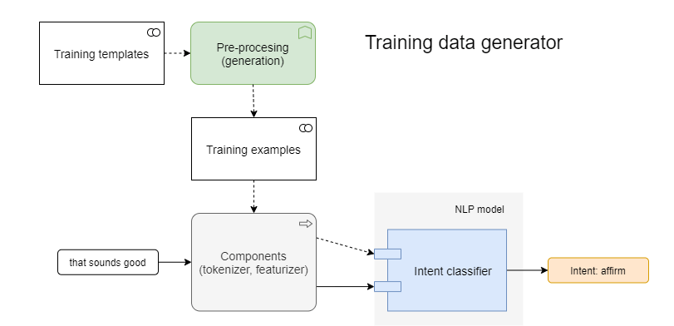
2. Training data generator

Slide 10
CONCLUSION
.
A chatbot is one of the simple ways to transport data from a computer without having to think for proper keywords to look up in a search or browse several web pages to collect information; users can easily type their query in natural language and retrieve information.

